Slide 1
Introduction to Machine Learning – Decision Trees Pt. 2
Dr. Ab Mosca (they/them)
Slides based off slides courtesy of Jordan Crouser (https://jcrouser.github.io/)

Slide 2
Plan for Today
Final project notes
Avoiding overfitting of decision trees
Bootstrap aggregation (“bagging”)
Random forests
Boosting

Slide 3
Final Project
Instructions out today!
Broken into milestones
Milestone 1 (proposal) is due by class on Monday!
Read the instructions; any questions?

Slide 4
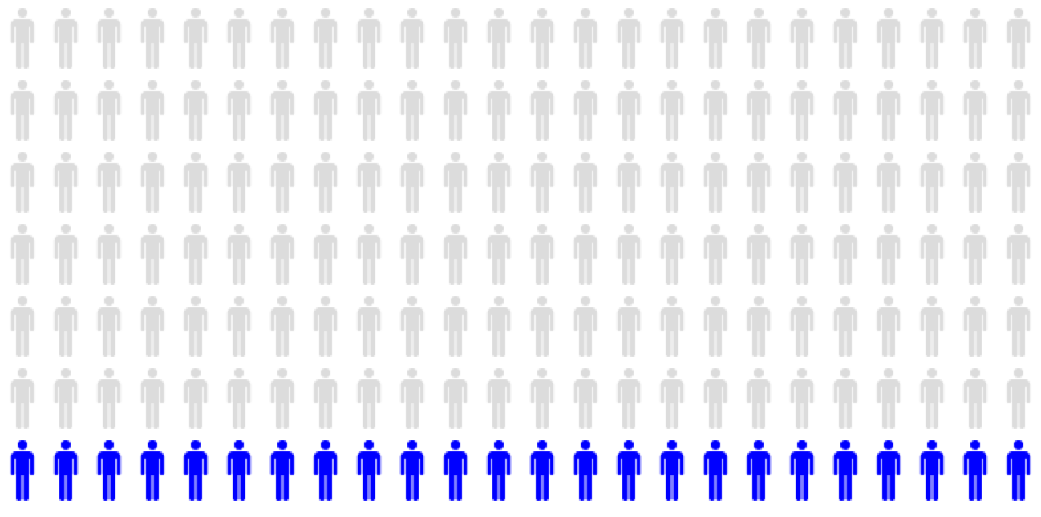

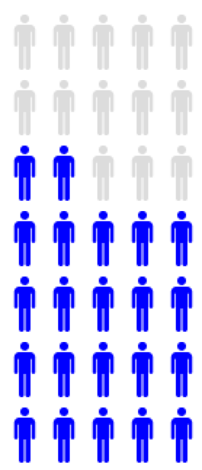


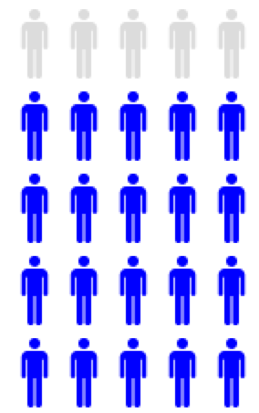

Flashback
VT / VF
EMD / Asystole / Other
Different!
-
+
+
-
Notes:
So what do you notice about this?

Slide 5
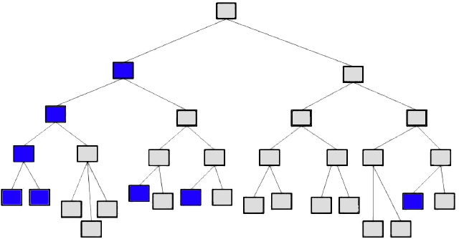
Flashback
Problem: high variance

Slide 6
Discussion
What can we do to combat high variance?
Notes:
bootstrap and aggregate!

Slide 7
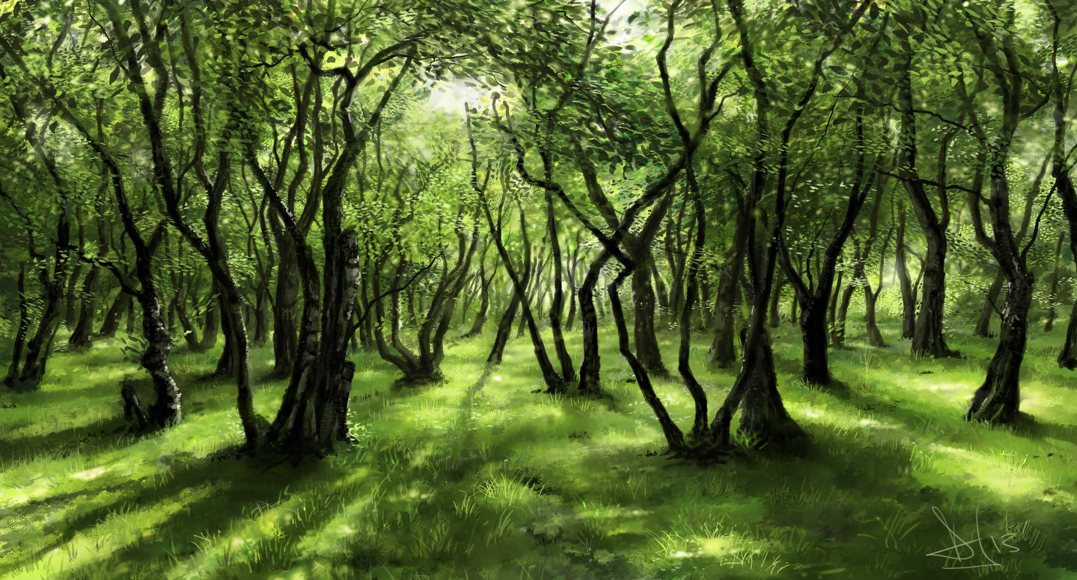
Bagging
Big idea: use regular old bootstrapping to generate a bunch of sample training sets, build trees for each one, and average their resulting predictions
Image courtesy Rachopin77 on DeviantArt
Notes:
Majority vote for classification

Slide 8
Estimating test error
Fun fact: there is a straightforward way to estimate the test error of a bagged model, without needing to use a test set or cross-validate!
Key: trees are repeatedly fit to bootstrapped subsets
Each bagged tree only trains on ~2/3 of the observations
The remaining ~1/3 are called the out-of-bag (OOB) observations

Slide 9




OOB error
Trained on this
observation?
Repeat for every observation,
average to get MSE or classification error
*with enough trees, this is essentially equivalent to LOOCV error
Notes:
We can predict the response for the out-of-bag ith observation using each of the trees in which that observation was OOB.
This will yield around B/3 predictionsfor the ith observation.
In order to obtain a single prediction for the ith observation, we can average these predicted responses (if regression is the goal) or can take a majority vote (if classification is the goal).
This leads to a single OOB prediction for the ith observation.
An OOB prediction can be obtained in this way for each of the n observations, from which the overall OOB MSE (for a regression problem) or classification error (for a classification problem) can be computed.
The resulting OOB error is a valid estimate of the test error for the bagged model, since the response for each observation is predicted using only the trees that were not fit using that observation.

Slide 10
Measuring predictor importance
With just one tree, it was easy to pick out the most important predictor (which one was it?)

Slide 11
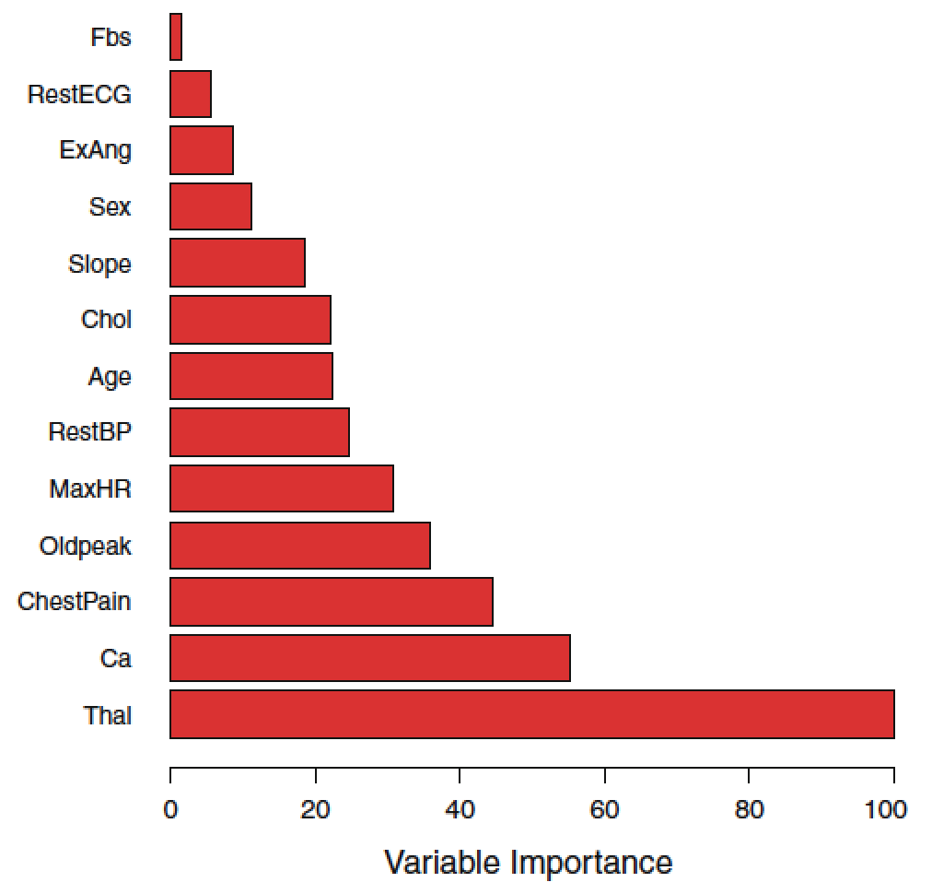
Measuring predictor importance
With lots of trees, we can’t just “read from the top”
Instead, we can look at average reduction in RSS or Gini due to splits on a given predictor

Slide 12

Just one problem…
One issue with bagging is that it sometimes gives us trees that are pretty highly correlated (why?)
Averaging highly correlated values doesn’t reduce variance as much as averaging uncorrelated quantities
If we have one
very strong predictor in the data set, most or all of the trees will use this predictor in the top split

Slide 13
Random forests
Strange idea: what if each time we go to make a split, we randomly limit the choice to some subset of predictors?

Slide 14
Random forests
Strange idea: what if each time we go to make a split, we randomly limit the choice to some subset of predictors?
Only consider m out of p predictors each time we decide on a split

Slide 15
Random forests
Strange idea: what if each time we go to make a split, we randomly limit the choice to some subset of predictors?
Only consider m out of p predictors each time we decide on a split
Roughly (p-m)/p splits won’t even consider that bully predictor, so other predictors will have a chance

Slide 16
Random forests
Strange idea: what if each time we go to make a split, we randomly limit the choice to some subset of predictors?
Only consider m out of p predictors each time we decide on a split
Roughly (p-m)/p splits won’t even consider that bully predictor, so other predictors will have a chance
Note: when m = p, this is just bagging!

Slide 17
Boosting
Previous methods: generate a bunch of training sets, fit a tree on each one independently, and aggregate results
Boosting works in a similar way, except that each tree is grown using information from previous trees

Slide 18
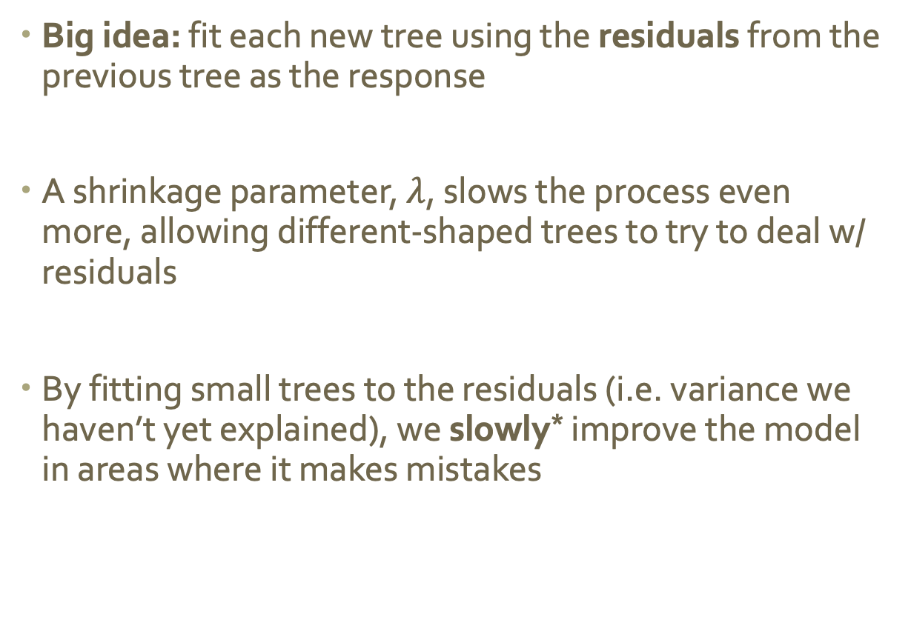
Boosting
Big idea: fit each new tree using the residuals from the previous tree as the response
A shrinkage parameter, $λ$, slows the process even more, allowing different-shaped trees to try to deal w/ residuals
By fitting small trees to the residuals (i.e. variance we haven’t yet explained), we slowly* improve the model in areas where it makes mistakes
* in general, statistical learning approaches that learn slowly tend to perform well

Slide 19
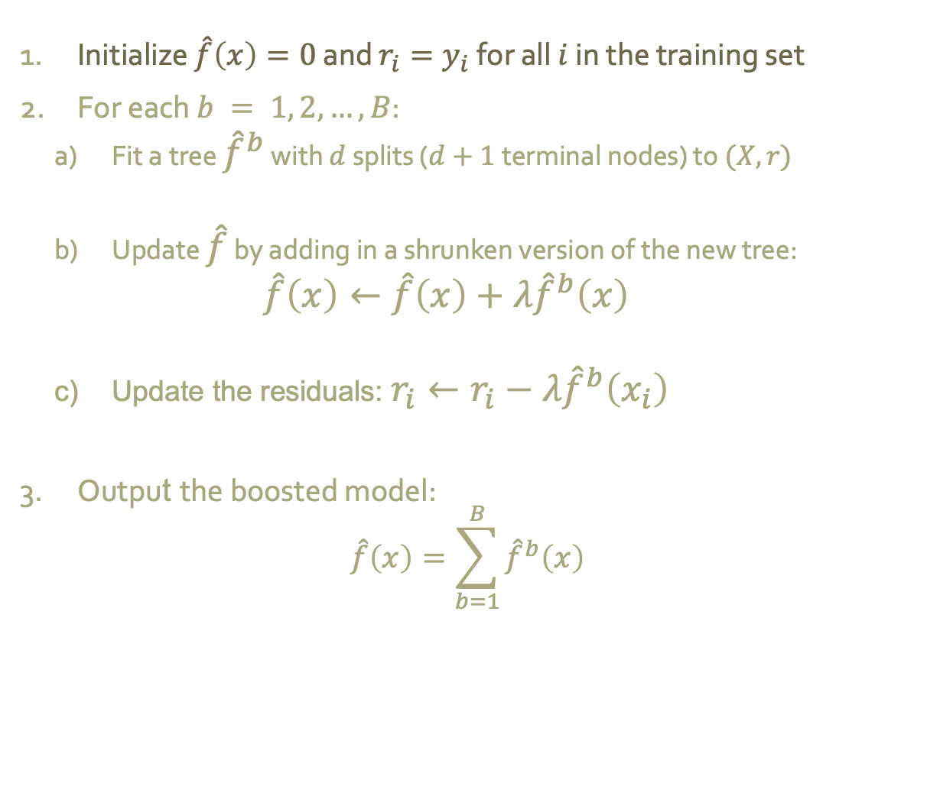
Boosting: algorithm
Initialize $\hat{f}\left(x\right)=0$ and $r_{i}=y_{i}$for all $i$ in the training set
For each $b = 1, 2,…, B$:
Fit a tree ${\hat{f}}^{b}$ with $d$ splits ($d+1$ terminal nodes) to $(X,r)$
Update $\hat{f}$ by adding in a shrunken version of the new tree:
$$\hat{f}\left(x\right)←\hat{f}\left(x\right)+λ{\hat{f}}^{b}\left(x\right)$$
Update the residuals: $r_{i}←r_{i}−λ{\hat{f}}^{b}\left(x_{i}\right)$
Output the boosted model:
$$\hat{f}\left(x\right)=\sum_{b=1}^{B}{{\hat{f}}^{b}\left(x\right)}$$
Notes:
Boosting has three tuning parameters:
1. The number of trees B. Unlike bagging and random forests, boosting can overfit if B is too large, although this overfitting tends to occur slowly if at all. We use cross-validation to select B.
2. The shrinkage parameter lambda, a small positive number. This controls the rate at which boosting learns. Typical values are 0.01 or 0.001, and the right choice can depend on the problem. Very small lambda can require using a very large value of B in order to achieve good performance.
3. The number d of splits in each tree, which controls the complexity of the boosted ensemble. Often d = 1 works wekk, in which case each tree is a sump, consisting of a single split. In this case, the boosted ensemble is fitting an additive model, since each term involves only a single carriable. More generally, d is the interaction depth, and controls the interaction order of the boosted model, since d splits can involve at most d variables.

Slide 20
Takeaways
Tree-based methods partition the predictors into a number of simple regions, and use the average value of each region to make predictions
While easy to interpret, trees typically won’t outperform other methods we’ve seen in terms of prediction accuracy
Bagging, random forests, and boosting all try to fix this by growing multiple trees and using “consensus prediction”
In lab, we will see that combining a large number of trees can result in dramatic improvements in prediction accuracy (at the expense of some loss in interpretability)

Slide 21
Activity
Consider the data below. By hand, use a random forest (if you are in group 1) or boosting (if you are in group 2) to generate a model that predicts Dose based on Age, Sex, BP, Cholesterol, and Na_to_K
Show all of the steps to your algorithm on the board
Age | Sex | BP | Cholesterol | Na_to_K | Dose
23 | F | HIGH | HIGH | 25.355 | 20
47 | M | LOW | HIGH | 13.093 | 15
47 | M | LOW | HIGH | 10.114 | 15
28 | F | NORMAL | HIGH | 7.798 | 20
49 | F | NORMAL | HIGH | 16.275 | 20
41 | M | LOW | HIGH | 11.037 | 15
60 | M | NORMAL | HIGH | 15.171 | 20
43 | M | LOW | NORMAL | 19.368 | 20
47 | F | LOW | HIGH | 11.767 | 15
23 | M | LOW | HIGH | 7.298 | 15
74 | M | HIGH | HIGH | 9.567 | 10
58 | F | HIGH | NORMAL | 14.239 | 10

